Slide 1
Border and Margin Properties:
Margins are used to create space around elements, outside of borders. With CSS, you have full control over the margins.
There are properties for setting the margin for each side of an element (top, right, bottom, and left).
CSS has properties for specifying the margin for each side of an element:
margin-top
margin-right
margin-bottom
margin-left
All the margin properties can have the following values:
auto - the browser calculates the margin
length - specifies a margin in px, pt, cm, etc.
% - specifies a margin in % of the width of the containing element

Slide 2
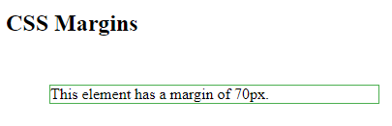
Example
Output:
<html>
<head>
<style>
div {
margin: 70px;
border: 1px solid #4CAF50;
}
</style>
</head>
<body>
<h2>CSS Margins</h2>
<div>This element has a margin of 70px.</div>
</body>
</html>

Slide 3
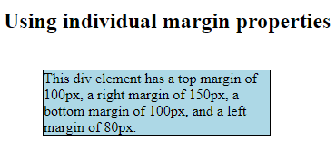
Example
Output:
<html>
<head>
<style>
div {
border: 1px solid black;
margin-top: 100px;
margin-bottom: 100px;
margin-right: 150px;
margin-left: 80px;
background-color: lightblue;
}
</style>
</head>
<body>
<h2>Using individual margin properties</h2>
<div>This div element has a top margin of 100px, a right margin of 150px, a bottom margin of 100px, and a left margin of 80px.</div>
</body>
</html>

Slide 4
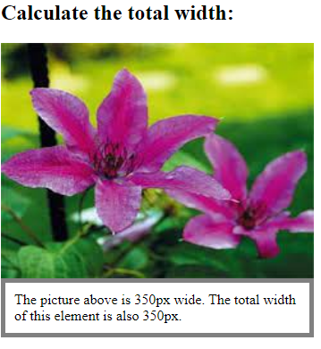
Example
Output:
<html>
<head>
<style> div { width: 320px; padding: 10px; border: 5px solid gray; margin: 0; } </style>
</head>
<body>
<h2>Calculate the total width:</h2>
<img src="img.jpg" width="350" height="263" alt="Klematis">
<div>The picture above is 350px wide. The total width of this element is also
350px.</div>
</body>
</html>

Slide 5
Formatting Blocks of Information
A webpage may consist of more than one block.
We can format all the blocks with single style or separate style for each and every block.
This can be achieved in three ways
1. Using <style> class
2. Using <div> tag
3. Using <span> tag

Slide 6
Using class
A class is defined a set of styles which can be applied as user choice.
Choices can be applied to a single type of element or may be anonymous and hence applicable to any element.
If you want to apply a style to a particular element use the following syntax
Selector.classname{property: value; property: value}
<selector class=”classname”>

Slide 7
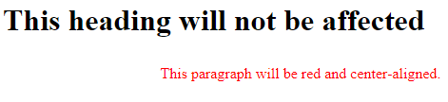
Example
<html>
<head>
<style> p.center { text-align: center; color: red; } </style>
</head>
<body>
<h1 class="center">This heading will not be affected</h1>
<p class="center">This paragraph will be red and center-aligned.</p>
</body>
</html>
Output:

Slide 8
Anonymous classes:
Sometimes you want to apply a piece of formatting too many different elements within a page but not necessarily to the entire page.
Instead of defining styles to individual elements we are creating a style class that can be applicable any number of tags in your HTML document.
Such classes are called anonymous classes. It has the following syntax
.classname { Property: value; Property: value; }
<selector1 class=”classname”> ………. <selector1>
<selector2 class=”classname”> ………. <selector2>

Slide 9
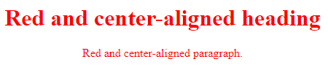
Example
<html>
<head>
<style> .center { text-align: center; color: red; } </style>
</head>
<body>
<h1 class="center">Red and center-aligned heading</h1>
<p class="center">Red and center-aligned paragraph.</p>
</body>
</html>
Output:

Slide 10
Using <div> tag:
An element in an HTML document is either a block element or an inline element.
A block would be something like a paragraph, while an inline might be something like text, a figure or an individual character i.e., part of block.
Each of these can be manipulated separately, rather than applying the formatting to the element itself,
a <div> ….. </div> pair of tags are wrapped around the elements.

Slide 11
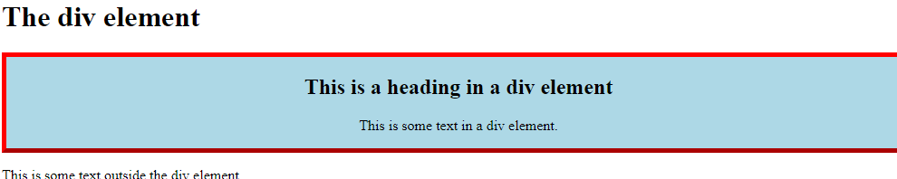
Example
Output:
<html>
<head>
<style>
.myDiv {
border: 5px outset red;
background-color: lightblue;
text-align: center;
}
</style>
</head>
<body>
<h1>The div element</h1>
<div class="myDiv">
<h2>This is a heading in a div element</h2>
<p>This is some text in a div element.</p>
</div>
<p>This is some text outside the div element.</p>
</body>
</html>

